Slide 1
HIT THE BAR
Developed by:
Tarunpreet Singh
Chashamdeep Kaur
Ashna Mehta
Jasmeet Singh Sidhu

Slide 2
Introduction
Features of the application
Elements in the app
Working display

Slide 3
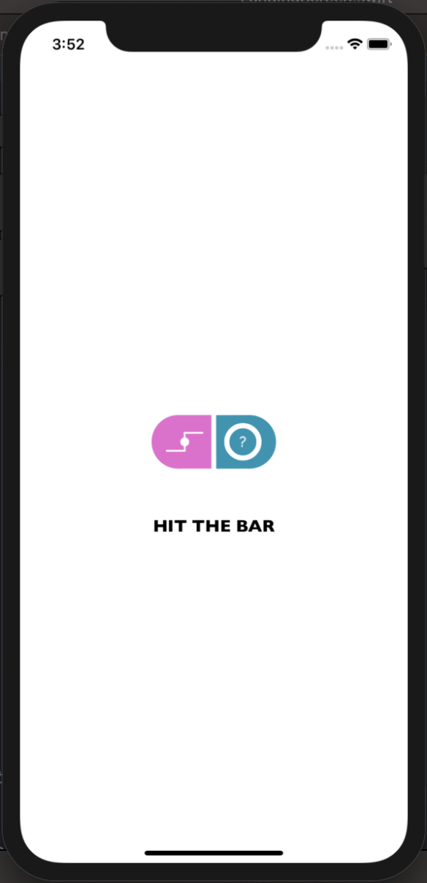
Launch Screen

Slide 4
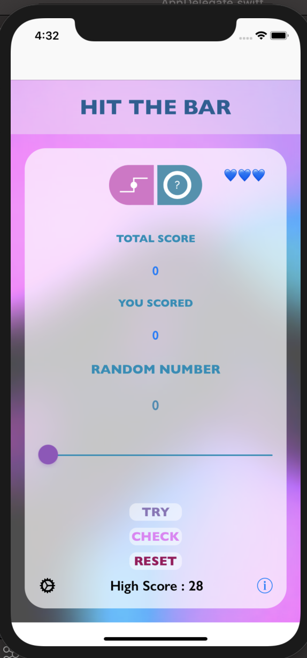
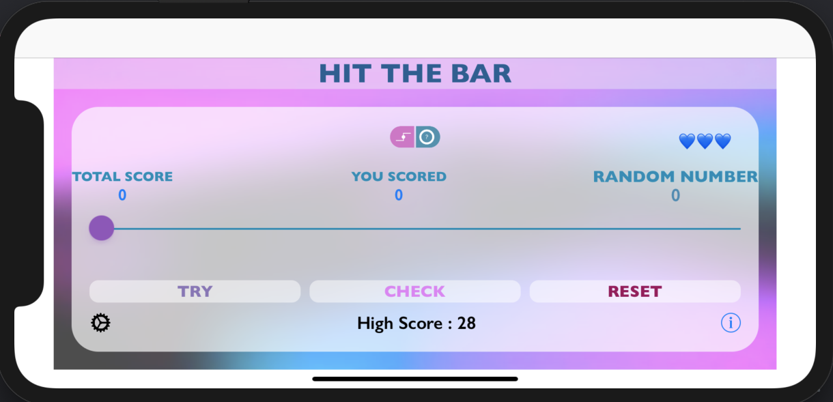
Home Screen

Slide 5
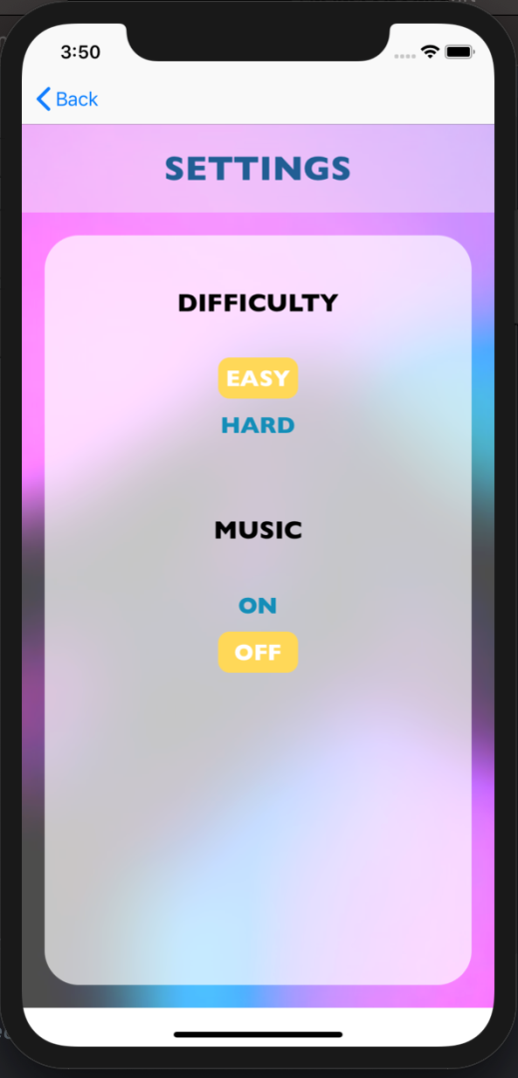

Features of the App
Levels of Difficulty - Easy / Hard
High Score display
User can have trials (re-spawn) per game
Has a Music control
Setting’s page
Home Screen

Slide 6
Elements on Home Screen
Total Score: It would keep updating the total score as the game continues for a complete run.
You Score: It would display the score for the current trial of the game only.
Random Number: A random number in range 1 to 100 would be generated by clicking the TRY BUTTON
Slide Bar: We try and make a guess of the generated random number on the Slide Bar and then check our guess using CHECK BUTTON
Reset Button: It would reset all the game and set Total Sore, You Score , Random Number and Slide Bar to the initial values; but would retain the High score.
High Score: It would carry the High Score of all the games played till now.
Setting and Info Button: These would provide the user to manipulate the basic settings of the app and the Info on how to play the game.
Lives remaining: It would have a display in number of hearts/ trials left with user in the current game.

Slide 7
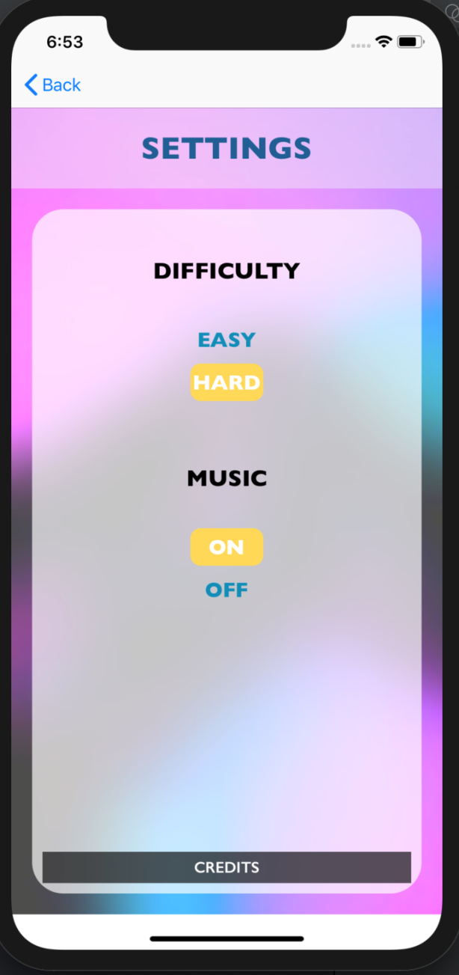
Settings
Difficulty Level: User will have the option to control the difficulty level through this section.
Music Control: User can control whether to switch On/Off the background music.

Slide 8
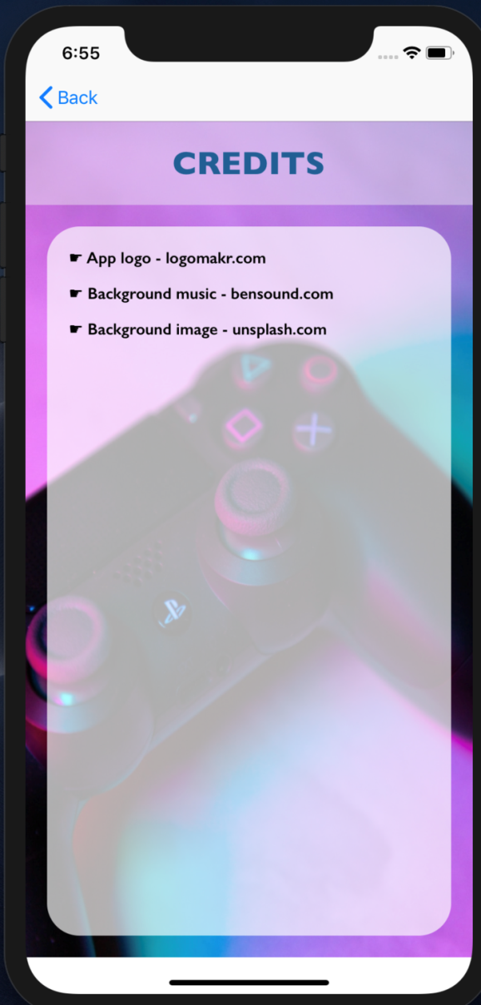
Credits (we pay the credits wherever due)

Slide 9
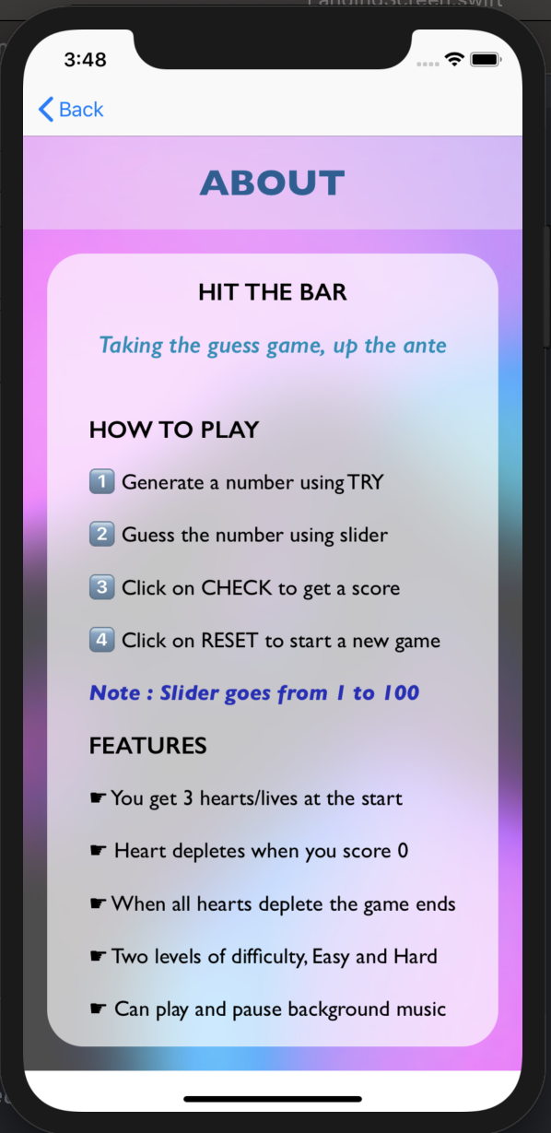
More Information

Slide 10

Any questions?

Slide 11


